Slide 1
ETMA+MT WHAT IT MEANS TO YOU
Digital Strategy--Globalization
July 2011

Slide 2
INTRODUCTION—HP’S ETMA+MT
You are already using Enterprise Translation Management (ETMA) to help with your globalization
Translation Memory (TM)
Terminology Management
Workflow and process automation
Expert and approved human translators
Machine Translation (MT) has now been added to ETMA services
Statistical MT trained on HP’s voice and words
Secure and private service for HP alone
25 languages available immediately
Saves time and money!
Notes:
Language = one-way translation or “language pair”. This means that English to French counts as one, and French to English as a second.

Slide 3
HOW ETMA+MT WORKS
You do not need to do anything!
Translations continue to flow through ETMA and find matches in translation memory
Only sentences for which there is no match in translation memory then go through MT
Everything is reviewed and modified, when necessary, by an expert, human translator (post-editing services) at an Approved HP supplier
All you need to do is save money!

Slide 4
POST-EDITING SERVICES
Expected quality of translations
HP expects the quality of post-edited content to be the same linguistic quality as would be expected and achieved by standard human translation, meaning that final content must be:
Comprehensible: an end user perfectly understands the content of the message
Accurate: it communicates the same meaning as the source text
Stylistically accurate: with style as good as that achieved by a human translator
Grammatically correct and using correct punctuation

Slide 5
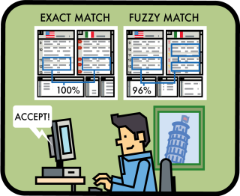
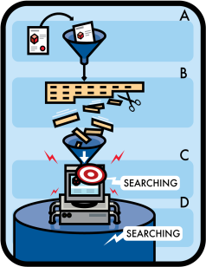
CURRENT TRANSLATION PROCESS
ETMA translation memory matching
DTP
Linguistic Review
Engineering hours
Supplier delivers translated content
Breakdown
New words
95% - 99%
85% - 94%
75% - 84%
ICR
Project
Mgmt
Supplier or CMS uploads content files to ETMA
ETMA identifies matches, terminology and “new words”
Translator reviews matches and translates new words
Supplier provides other project services
Notes:
- Supplier works on ETMA, stakeholder does not

Slide 6
ETMA+MT TRANSLATION PROCESS
Translation memory matching plus machine translation service
-
ETMA
MT
engine
DTP
Linguistic Review
MT engine
Engineering hours
Breakdown
Zero new words
95% - 99%
85% - 94%
75% - 84%
Supplier delivers translated content
MT engine
ICR
Project
Mgmt
Supplier or CMS uploads content to ETMA
MT engine
ETMA identifies matches, terminology and “new words”
Supplier provides other project services
Translator reviews matches
“New words” go through machine translation
Notes:
One machine translation has been trained for each languages, using HP’s huge corpus of already-translated, approved content.

Slide 7
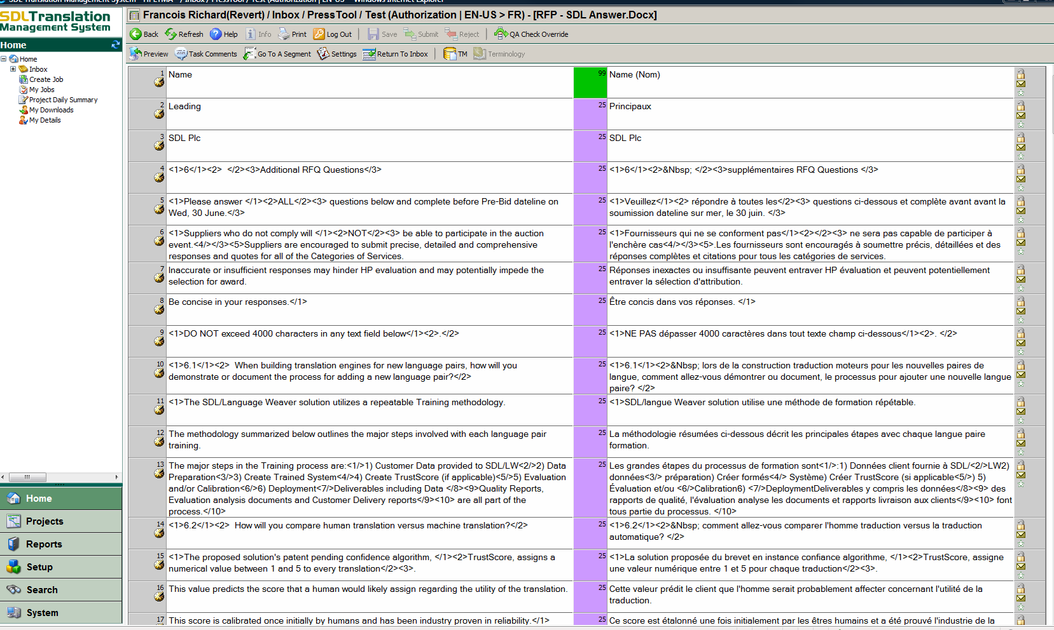
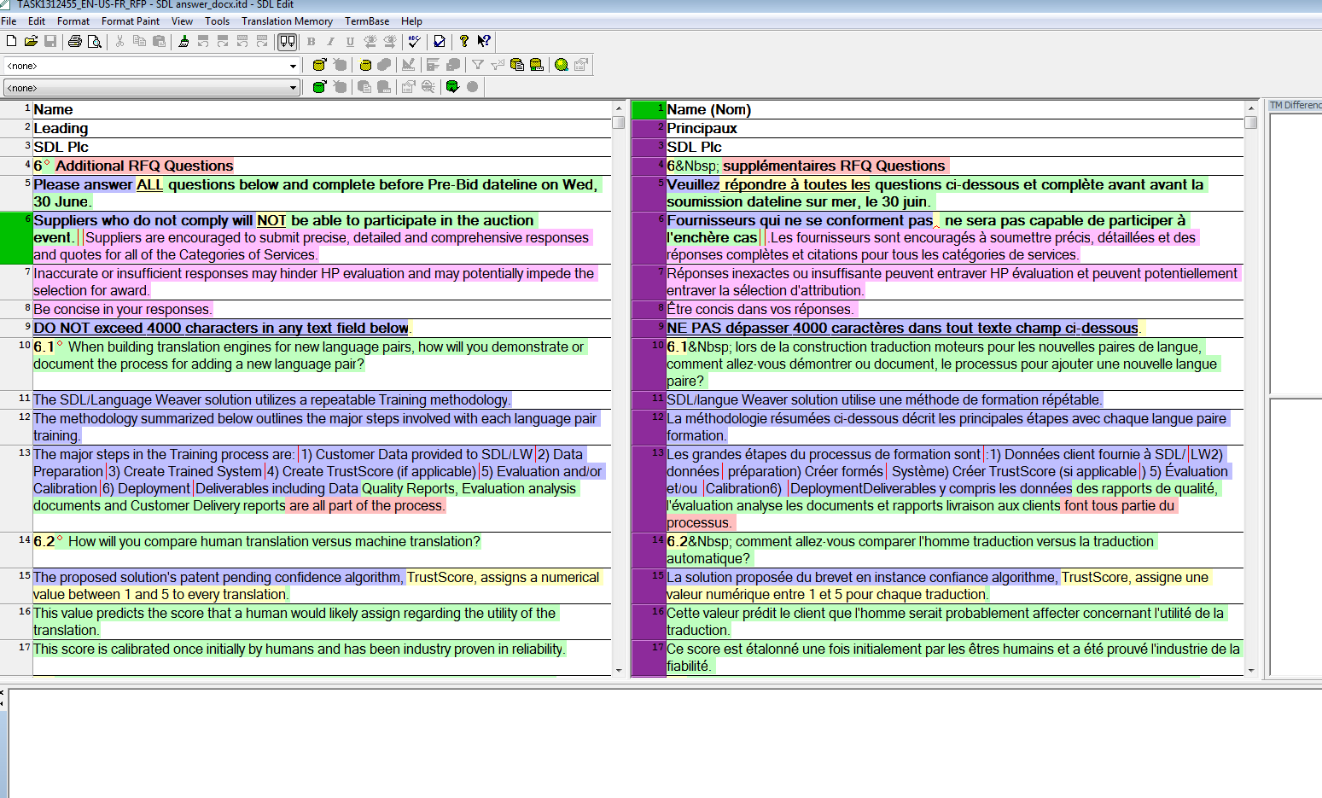
HOW THE TRANSLATOR WORKS
Content is colour-coded to indicate perfect or 100% matches, high or low fuzzies, repetitions, and machine translations, so that the translator knows what to look for
Notes:
Machine translations need a different type of modification to fuzzy matches: MT may have all the right words but in the wrong order, or may use tense or gender incorrectly; fuzzy match may have one or more wrong words.

Slide 8
PRICING
Approved translation suppliers are contracted to review, modify and approve HP’s machine translated sentences. This is often called “post-editing”.
Post-editing prices are a percentage of New Word prices.
The translation supplier will charge HP at a discount rate of New Word pricing for words that they post-edit
In addition, the machine translation service costs $0.015 per word for MT service hosting, management and training.
Together, the cost-per-word will be significantly lower than the full New Word prices.
$Post-edit+MT Service < $New Words

Slide 9
BILLING PROCESS FOR MT SERVICES
Translation services using MT will consist of two parts
1. INVOICE sent
From: supplier
To: HP stakeholder
2. IC BILLING
From: Digital Strategy Team
To: HP stakeholder
HP Stakeholder
WORD BREAKDOWN | COST
MT-translated words | 60% of New Word Cost
75% - 84% | 59% of New Word Cost
85% - 94% | 55% of New Word Cost
95% - 99% | 29% of New Word Cost
Cost analysis
Post-edit words: $0.015 per word
Notes:
This $0.015/word cost is in addition to post-editing services
This cost pays for:
Training the machine translation engine on HP’s content
Hosting the MT engines
Supporting the MT service.
*Note: These two billings are separate and may arrive at different times

Slide 10
SAVINGS EXAMPLE
 | Without MT | With MT
New word cost | $0.17
MT service | N/A | $0.015
MT post-editing | N/A | * $0.11
Total per word | $0.17 | $0.125
Savings |  | $0.045
25% savings on new content translation
* Assuming a 35% discount on ‘new word’ rate

Slide 11
DEPLOYMENT
How MT will be deployed
Digital Strategy Globalization team is working with all approved translation suppliers to:
Identify translation programs where this process will be beneficial
Implement the changes in ETMA workflows
The Translation Program team will let you know when it has been implemented for your programs so that you can measure and report on cost savings.
From a process perspective, nothing changes for you as a stakeholder
just review your quotes and invoices where suppliers will charge for post-editing services, and IC billing charge for the MT service

Slide 12
OTHER USES FOR ETMA + MT
There may be content that you can now translate at very low cost
Content where translation need not be perfect can be translated through ETMA+MT without post-editing:
Knowledge Bases
Internal documents
Non-contractual content for customers where today only English is provided due to budget
Cost: $0.015/word for any sentences not matched in translation memory
If you would like to find out more, contact the Digital Strategy Globalization team: alison.toon@hp.com

Slide 13
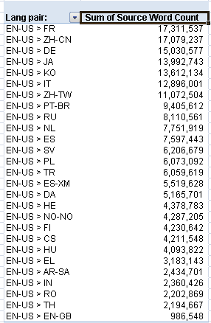
HP data used for training:
Lang pairs available:
Validation mark 70% | Validation mark 50%
Brazilian Portuguese | Finnish
Danish | Japanese
Dutch | Korean
English (US) to English (GB) | Thai
French
French to English (US)
German
Greek
Indonesian
International Spanish
Italian
Norwegian
Polish
Romanian
Russian
Simplified Chinese
Spanish
Swedish
Traditional Chinese
Simp. Chinese to English (US)
Japanese to English (US)

Slide 14
More info on MT Service…
An FAQ section as well as presentation and training material can be found at ETMA MT Service page.
To get help or raise a Support ticket, use the section ETMA Support page.

