Slide 1
MT on ETMA For Project Managers and Translators
François Richard
March, 2014

Slide 2
Facts on MT at HP
Statistical engine (probabilities using bilingual and monolingual model)
Provided by Microsoft: Microsoft Translator
Validation of PEMT discounts using MT engines trained using HP Cross-BU data (HP ‘generic’ or ‘baseline’ engines)
Production MT engines trained using program specific ETMA TMs.
25 language pairs in production with possibility to add more.
Integrated to ETMA (combining TM and MT, priority given to TM)

Slide 3
Roles and Responsibilities
Globalization:
MT engine analysis, selection.
MT training, ETMA setup.
PEMT quality improvement.
Global Procurement (GP):
Technology sponsor.
Mandates implementation of PEMT to all Technical content translation jobs.
Negotiates and enforces PEMT cost per word in ASL contract.
Translation service provider:
Provides skilled translator to perform post editing work on MT segments when carrying out translation task.
Feedback quality issues to ETMA Service Desk directly to log and resolve MT related issues with Globalization team.
Stakeholder:
Reviews translated content as usual to ensure translation quality is not affected.

Slide 4
PEMT Implementation Scope
Global Procurement mandates that PEMT shall be implemented to all translation work in HP.
Technical content type:
Mandatory to implement PEMT to all new and existing programs in ETMA.
All approved suppliers to adopt amended contract which includes terms and cost of PEMT.
Other content type: Deploy PEMT after reviewing with supplier and GP.
Target languages supported: See next slide.

Slide 5
Languages in Scope and new PEMT discounts
 |  | TC | MKTG |  |  | TC | MKTG
 | EN-US > DA | 25% | 20% |  | EN-US > KO | 20% | 20%
 | EN-US > DE | 25% | 20% |  | EN-US > NL | 25% | 20%
 | EN-US > EL | 25% | 20% |  | EN-US > NO-NO | 25% | 20%
 | EN-US > ES | 25% | 20% |  | EN-US > PL | 20% | 20%
 | EN-US > ES-XM | 25% | 20% |  | EN-US > PT-BR | 25% | 20%
 | EN-US > FI | 20% | 20% |  | EN-US > RO | 25% | 20%
 | EN-US > FR | 25% | 20% |  | EN-US > RU | 20% | 20%
 | EN-US > IN | 20% | 20% |  | EN-US > SV | 25% | 20%
 | EN-US > IT | 25% | 20% |  | EN-US > TH | 20% | 20%
 | EN-US > JA | 20% | 20% |  | EN-US > ZH-CN | 20% | 20%
 |  |  |  |  | EN-US > ZH-TW | 20% | 20%

Slide 6
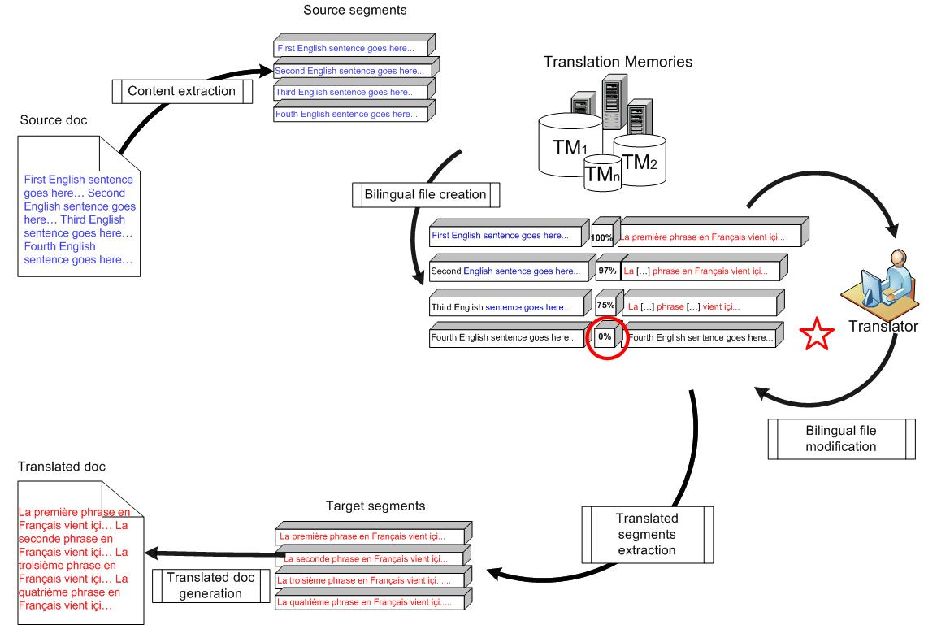
Integration of MT in ETMA (1)

Slide 7
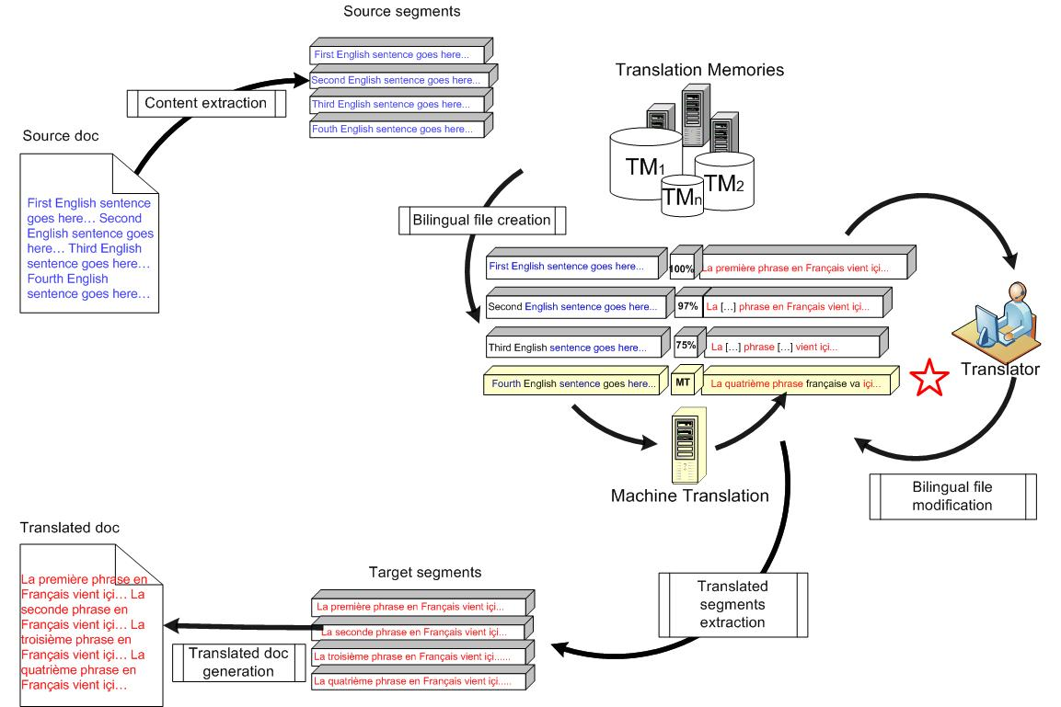
Integration of MT in ETMA (2)

Slide 8
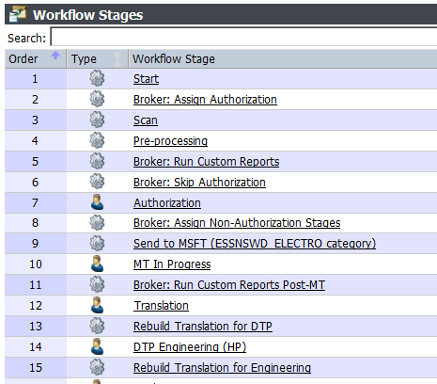
ETMA workflow stages

Slide 9
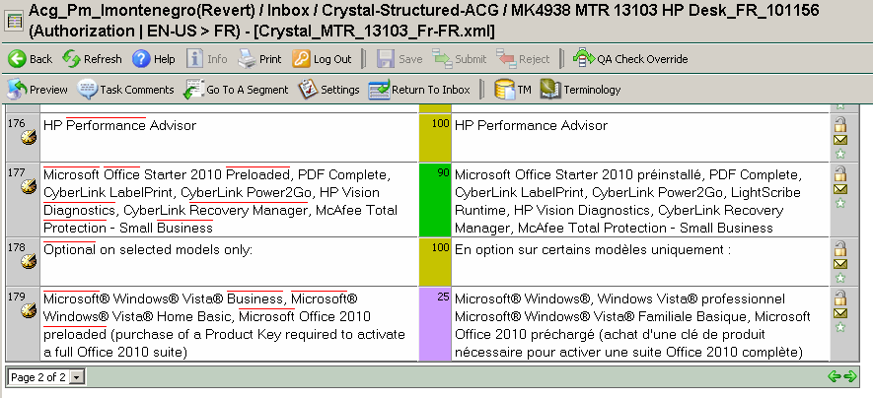
MT in translator tools (1)
Online UI

Slide 10
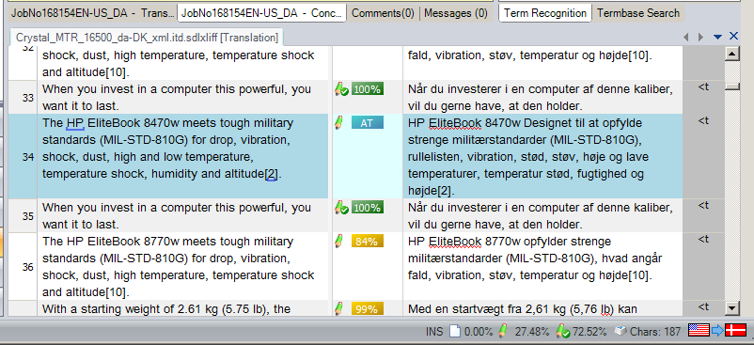
MT in translator tools (2)
SDL Trados Studio 2011

Slide 11
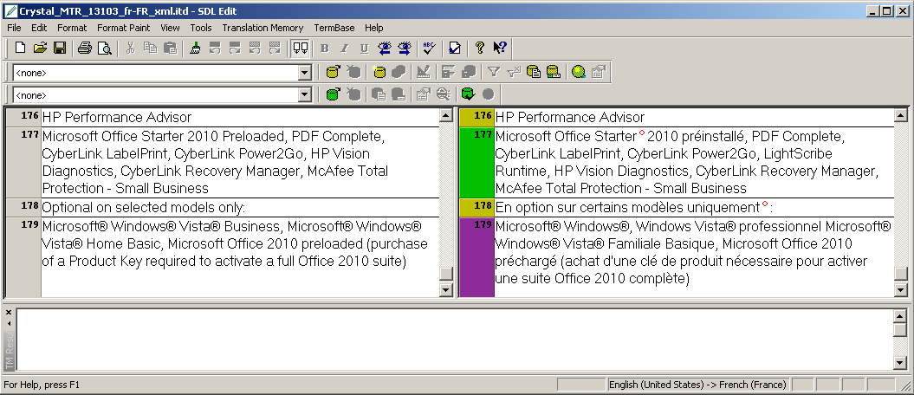
MT in translator tools (3)
SDL Edit

Slide 12
MT Reporting (1)
MT word count information has been added into the following existing ETMA reports:
Language Pair Word Count Report
Job Summary Report
Custom Job Download Report

Slide 13
MT Reporting (2)
Each MT job will generate two word count reports. The billing must be based on the report called “…PostMT.xls” that accounts for the MT words.

Slide 14
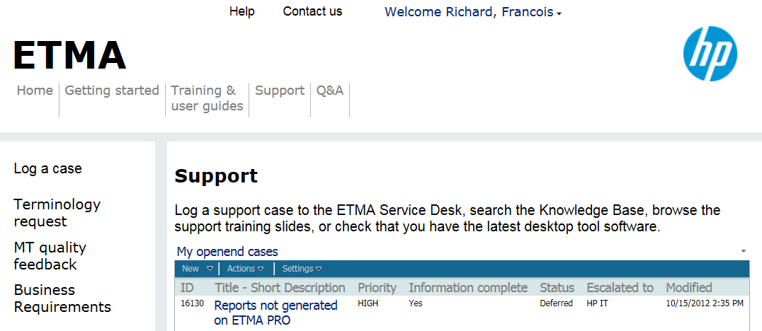
MT Quality feedback
Post-editors can inform MT owners of any systematic structural errors that can be corrected. This information will be use to re-train MT engines.
To do so or share any feedback, required procedure is to use MT Quality Feedback form that is available on ETMA Support portal to capture any MT engine errors that are repetitive and could potentially be corrected.
Notes:
Re-training decision will be made based on following factors:
Amount of feedback collected from translators
ETMA TM growth since last training (50% increase in # of segments)
Priority of program

Slide 15
Backup slides

Slide 16
Rules around MT and Post-editing
With revised PEMT pricing model (see below), use of MT in ETMA is mandatory for Technical content - No exception.
PEMT discount schema (*) has been updated in 2013: Either 20% and 25% discounts for existing lang pairs.
For new lang pairs in FY14, PEMT discount is 20% (with possibility for HP to revise this discount).
Suppliers should NOT engage with business stakeholder(s) directly to discuss MT issues, but instead must work with the Globalization team (owners of the ETMA Support Portal)
Quality of the final translated content (after Post-editing) delivered to HP programs must comply with HP’s standard translation quality requirements.
Translation suppliers’ responsibility:
Translators and other workers assigned to PEMT tasks must have proven experience in MT post-editing
Quoting, as well as the invoice price, must be aligned with agreed PEMT pricing, and must be applied consistently. No increase in pricing will be accepted.
If translators want to report raw MT quality issues, it must be done via ETMA Support Portal, using the MT Quality Feedback form. Translation suppliers must use this process to inform HP of any repetitive MT engine error.
Notes:
* There are a few exceptions to this schema

Slide 17
Language pairs available
In yellow, the ones trained with HP data
English (US) to xxxx: |  | xxxx to English (US):
English (US) to Arabic |  | Arabic to English (US)
English (US) to Brazilian Portuguese |  | Arabic to French
English (US) to Bulgarian |  | Arabic to Spanish
English (US) to Czech |  | Bulgarian to English (US)
English (US) to Danish |  | Czech to English (US)
English (US) to Dutch |  | Danish to English (US)
English (US) to English (GB) |  | Dutch to English (US)
English (US) to Finnish |  | Finnish to English (US)
English (US) to French |  | French to Arabic
English (US) to German |  | French to English (US)
English (US) to Greek |  | French to German
English (US) to Hebrew |  | French to Spanish
English (US) to Hungarian |  | German to English (US)
English (US) to Indonesian |  | German to English (US)
English (US) to International Spanish |  | German to French
English (US) to Italian |  | German to Spanish
English (US) to Japanese |  | Hebrew to English (US)
English (US) to Korean |  | Hungarian to English (US)
English (US) to Norwegian |  | Indonesian to English (US)
English (US) to Polish |  | Italian to English (US)
English (US) to Romanian |  | Italian to Spanish
English (US) to Russian |  | Japanese to English (US)
English (US) to Simplified Chinese |  | Korean to English (US)
English (US) to Spanish |  | Norwegian to English (US)
English (US) to Swedish |  | Polish to English (US)
English (US) to Thai |  | Portuguese to English (US)
English (US) to Traditional Chinese |  | Romanian to English (US)
English (US) to Turkish |  | Russian to English (US)
 |  | Simp. Chinese to English (US)
 |  | spa to English (US)
 |  | Spanish to Arabic
 |  | Spanish to French
 |  | Spanish to German
 |  | Spanish to Italian
 |  | Swedish to English (US)
 |  | Thai to English (US)
 |  | Traditional Chinese to English (US)
 |  | Turkish to English (US)
Also now available:
Bengali ⇆ English (US)
Estonian ⇆ English (US)
Hindi ⇆ English (US)
Lithuanian ⇆ English (US)
Presian ⇆ English (US)
Pashto ⇆ English (US)
Serbian ⇆ English (US)
Slovak ⇆ English (US)
Somali ⇆ English (US)
Slovenian ⇆ English (US)
Ukrainian ⇆ English (US)
Urdu ⇆ English (US)

