Slide 1
Process to Download ETMA Software
September, 2018

Slide 2
Contents of Slide set
Background
Installing Translator Desktop Tools (first time)
SDL Trados Studio 2017
SDL Multiterm 2017

Slide 3
Background
All translators will need to download the desktop tools described in this procedure.
These desktop tools will be used to translate the SDL TMS packages (downloaded and uploaded) from ETMA.
SDL Trados Studio requires a license / activation code after the 30 days trial period.
Users with an account registered with SDL will find the activation code available under the “account area”. In the case of new ETMA users, your vendor organization’s Supplier Point of Contact will distribute the required licenses.
Only SDL Trados Studio on its versions 2017 is supported by the ETMA Service Desk.

Slide 4
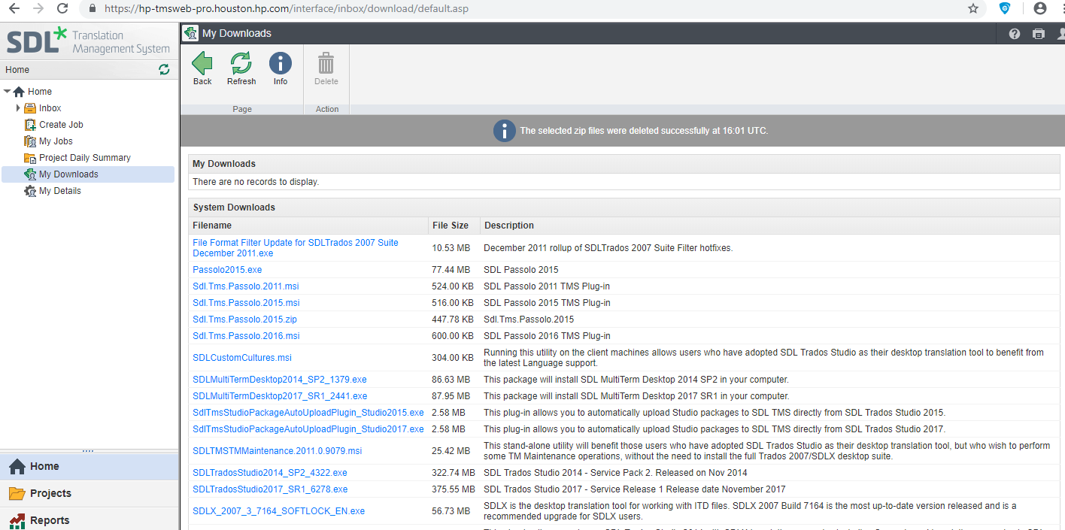
Current versions of desktop software available in ETMA.
Main components:
SDL Trados Studio 2017
SDL Multiterm 2017
Please go to “My Downloads”
in ETMA to download the
latest software

Slide 5
Installation Procedure Outline
The following software installers will need to be run, in this order.
SDL Trados Studio 2017
SDL Multiterm 2017

Slide 6
Installing SDL Trados Studio 2017

Slide 7
Installing SDL Trados Studio 2017
Log into ETMA, go to “My Downloads”,
then in the “System Downloads” area,
click on “SDLTradosStudio2017_SR1_6278.exe”
Click on “Save” then “Run”. The installer for SDL Trados Studio 2017 should install this software.

Slide 8
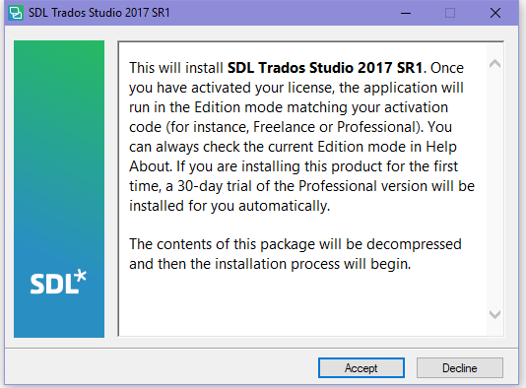
Installing SDL Trados Studio 2017
An initial agreement will appear; click “Accept” to continue

Slide 9
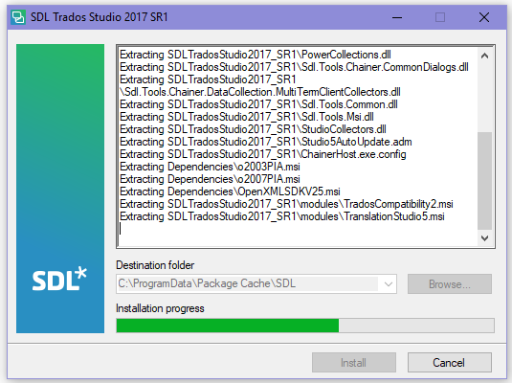
Installing SDL Trados Studio 2017
Select the “Destination Folder” and click “Next” to continue.

Slide 10
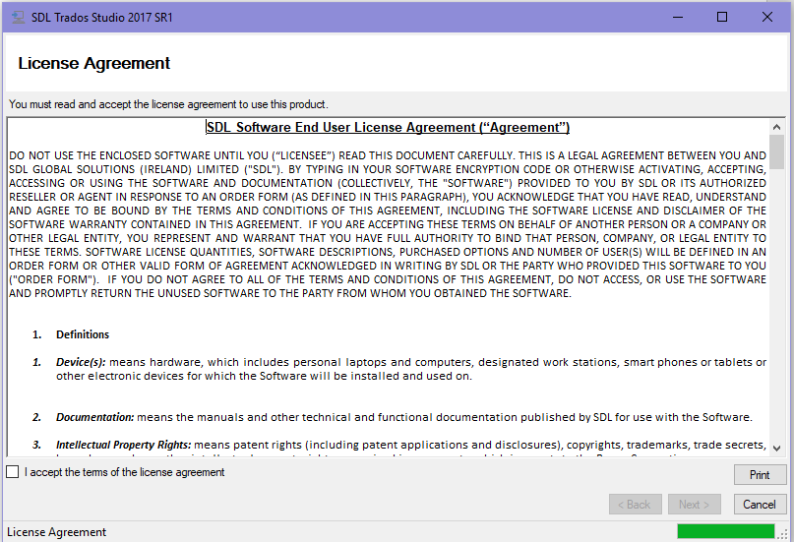
Installing SDL Trados Studio 2017
Accept the “License Agreement” and click “Next” to continue.

Slide 11
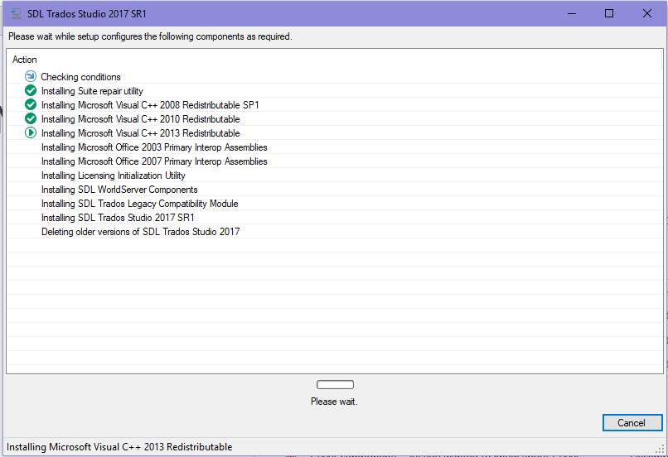
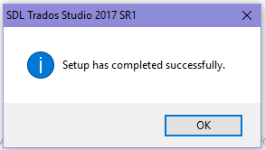
Installing SDL Trados Studio 2017
Once the components are installed, the following confirmation message will be displayed. Click OK.
SDL Trados Studio 2017 will be available in
Start > Programs > SDL > SDL Trados Studio 2017.

Slide 12
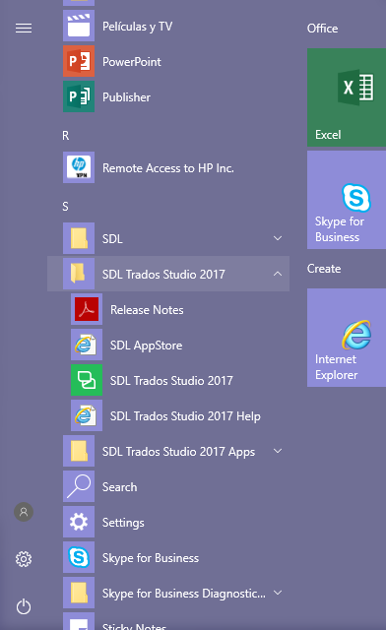
Installing SDL Trados Studio 2017
SDL Trados Studio 2017 will be available now in your programs, double click to launch it.

Slide 13
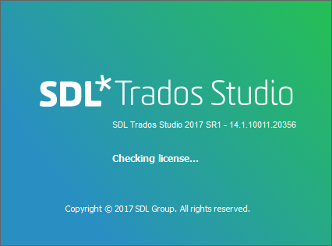
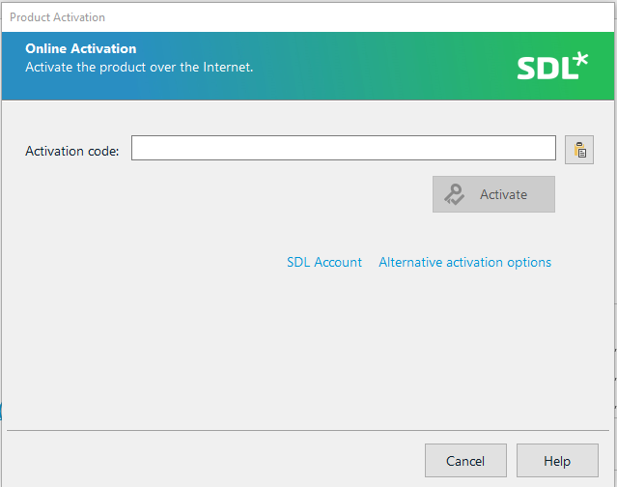
Installing SDL Trados Studio 2017
Enter your SDL Trados Studio 2017 Activation Code number and click “Activate” to start the program.

Slide 14
Installing Multiterm 2017

Slide 15
Installing Multiterm 2017
Log into ETMA, go to “My Downloads”, then in the “System Downloads” area, click on “SDLMultiTermDesktop2017_SR1_2441.exe” and then Save the file.

Slide 16
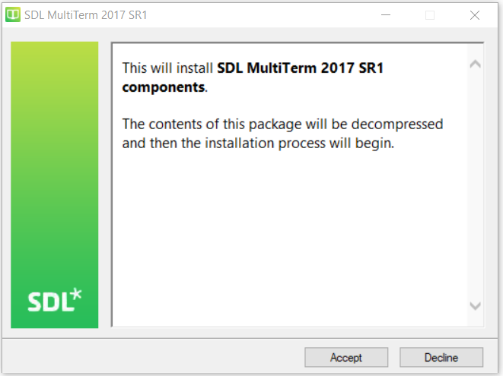
Installing Multiterm 2017
Double click on the downloaded file and choose Run to launch the installer.
Click “Accept” to continue

Slide 17
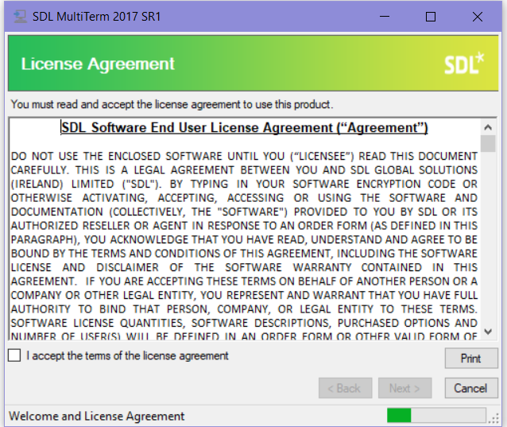
Installing Multiterm 2017
After files are extracted, accept the “License Agreement” and click “Next” to continue.

Slide 18
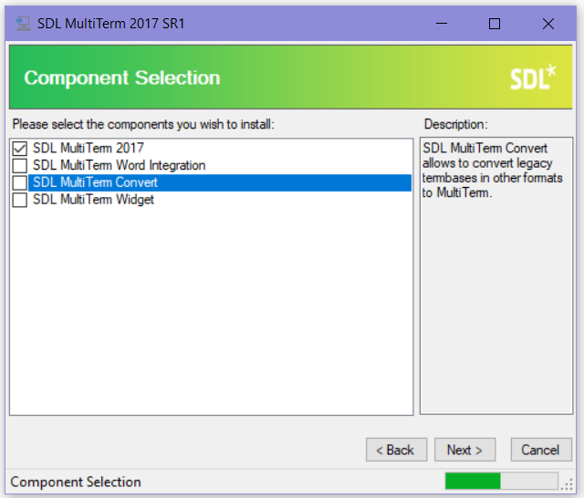
Installing Multiterm 2017
A list with the components available for installation will be displayed. Tick the checkbox for SDL MultiTerm 2017 since it is the only component that you need to install.

Slide 19
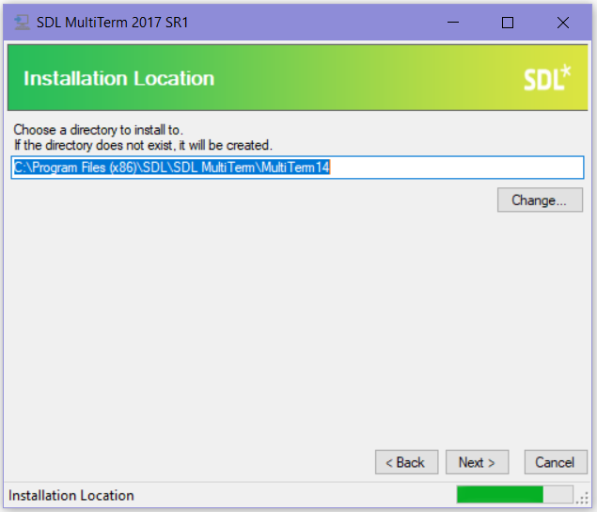
Installing Multiterm 2017
Choose an installation location and then click Next.

Slide 20
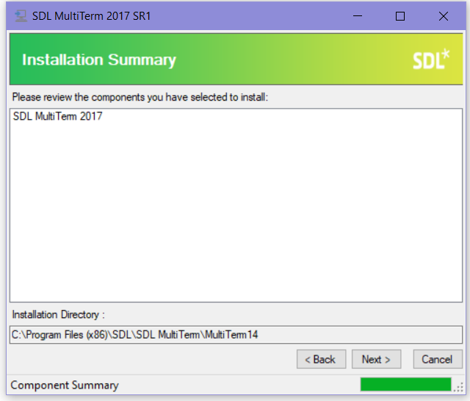
Installing Multiterm 2017
Review the components that are going to be installed and then click Next.

Slide 21
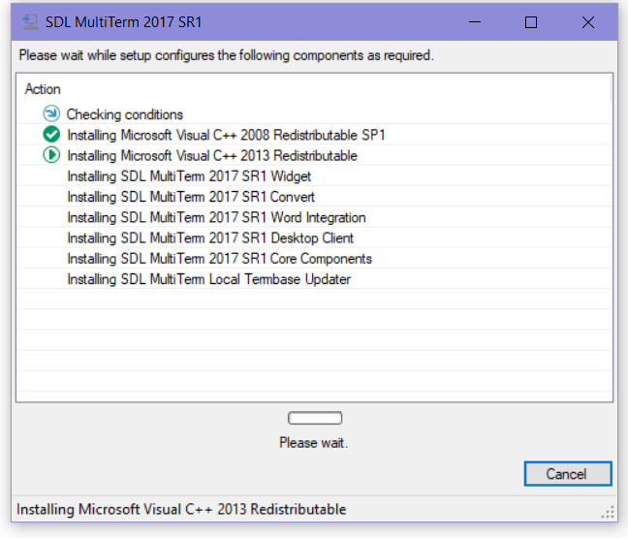
Installing Multiterm 2017
The MultiTerm installer will install MultiTerm Desktop and all its required components.

Slide 22
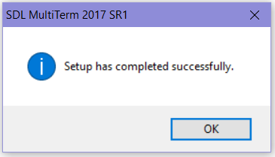
Installing Multiterm 2017
Once the components are installed, the following confirmation message will be displayed. Click OK.
SDL MultiTerm 2017will be available in Start > Programs > SDL > SDL MultiTerm 2017.

Slide 23
Any Questions?
If any questions, contact the ETMA Service Desk!

Slide 24
Thank you

