Slide 1
ETMA Perfect Match
Overview
ETMA Service Desk
November 2022

Slide 2
Perfect Match
PerfectMatch is a tool used by the system to pre-translate files.
PerfectMatch takes translations from previously translated versions of the same document, or other documents from the same folder structure, and applies the translations to identical segments in new tasks. PerfectMatch also checks segments for context match as well as source text match. PerfectMatch is performed during the preprocessing workflow step when files in new jobs are being prepared for translation.
Segments translated by PerfectMatch are automatically locked and are marked as Confirmed translations.
Only translations created and stored in SDL TMS can be used by PerfectMatch.
PerfectMatch is applied before Translation Memory.

Slide 3
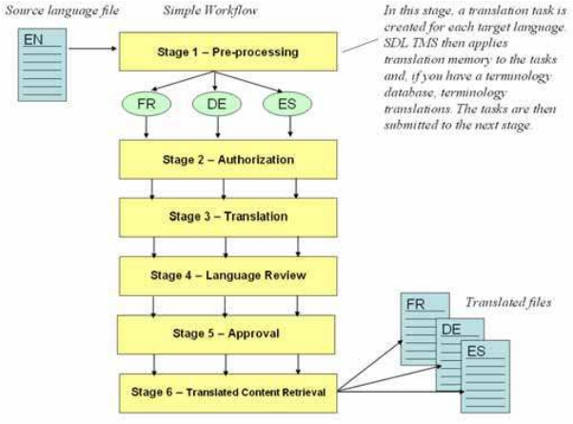
Perfect Match in Workflows
SDL TMS uses workflows to control the passage of tasks through the translation process.
A workflow consists of a number of separate workflow steps arranged in a sequence. Each step contains a different piece of processing to be performed on a task. Some steps are performed by the SDL TMS application, and some are performed by people. Steps performed by SDL TMS are known as ‘System’ steps and steps performed by people are known as ‘Human’ steps.
In the example workflow below, the first step is Pre-processing. Pre-processing is a System step where translation tasks are created, and translation memory and PerfectMatch are applied. The second step is Authorization, this is a human step where a person gives the authorization for translations to be performed.

Slide 4
Perfect Match Setup
Setting | Description
PerfectMatch Enabled | This option is selected to enable the Perfect Match on the configuration
Include tasks from active jobs | This option allows the Perfect Match to include completed tasks from active jobs within the candidate list
Exact filename match | Apply Perfect Match only where old and new files have exactly the same name
Filename regular expression | Use a regular expression to include items from filenames that would prevent their selection for perfect matching.
Filename regular expression replace template | Use a regular expression to negate items from filenames that would prevent their selection for perfect matching.
Exact folder match | Apply Perfect Match only when the old file came from the exact folder as the new file
Exact organization match | Apply Perfect Match where the old files where also created unde the same Organization
Exact configuration match | Apply Perfect Match where the old files where also created unde the same Configuration
Maximum file age (days) | Files older than this are not considered for Perfect matching. The age is expressed in days.
Maximum number of candidates | Limit the number of files used for Perfect Matching. For example, if the limit is 5, the 5 files containing the most matches will be selected.
Enable additional PerfectMatch filtering | Select this to enable the job creator to view and filter the list of files selected for Perfect Matching.

Slide 5
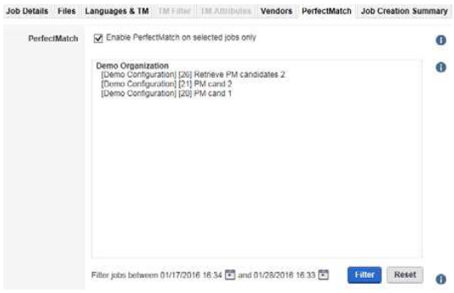
Perfect Match options at Job Creation
If you choose a configuration that contains PerfectMatch options, the PerfectMatch tab will be enabled.
PerfectMatch translations are taken from earlier versions of the same file or related files that were previously translated and approved in SDL TMS.
If the configuration you have selected contains PerfectMatch options, you can use this tab to limit the selection of files to be used by PerfectMatch to files that were translated during a specified date range.
When you select Enable PerfectMatch on selected jobs only, the tab displays a list of all jobs that could be checked for the presence of files which could be used by PerfectMatch.
You filter jobs out of the list using the date on which the job was created. Use the calendar icons to create a date range and click Filter, jobs created outside the date range are removed from the list. To restore the list to its original state, click Reset.
If Enable PerfectMatch on selected jobs only is selected when the job is created, only the jobs listed here will be considered by PerfectMatch.
Note: This tab is disabled if the configuration you have chosen does not contain PerfectMatch filtering options.

Slide 6
Perfect Match options at Job Creation [2]
Field | Description
Enable PerfectMatch on selected jobs only | Select this to enable PerfectMatch job filtering. When you select this option a list of jobs appears in the box below. These are jobs that could potentially contain files to be used by PerfectMatch. For example, if the configuration you have chosen uses Organization as a PerfectMatch file selection condition, all jobs for that organization will be listed. At this point the list is not a list of jobs that definitely contain files which can be used by PerfectMatch. This is because you have not yet created the job and SDL TMS does not actually know what files will be included in the job. Because of this no file name matching can take place. You can now refine the list by specifying a date range using the Filter jobs between option Note: Once you have selected this option you must specify a date range. If you decide not to filter the jobs by date, clear this option.
Filter jobs between | This is where you create a date range and then filter jobs falling outside the date range out of the list. First, create a date range using the calendars to define the range start and end dates. Click Filter. When you click Filter, all jobs created outside the date range are removed from the list. From the remaining jobs, select the ones that you want to be used by PerfectMatch. When you select a job, the job description (if there is one) is displayed at the bottom of this box. You can click Reset at any time to restore the complete list of jobs. When you actually create the new job, the jobs selected here will be checked for files which can be used by PerfectMatch.

