Slide 1
MT at HP
Machine translation and HP’s language services
François Richard, May 9th 2012

Slide 2
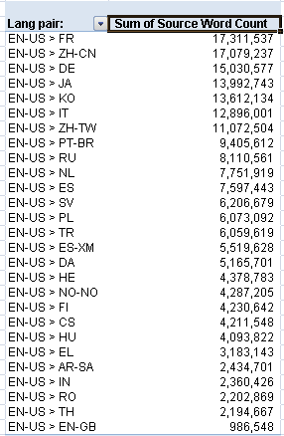
HP data used for training:
Lang pairs available:
Brazilian Portuguese | French to English (US)
Danish | Japanese to English (US)
Dutch | Simp. Chinese to English (US)
Finnish
French
German
Greek
Indonesian
International Spanish
Italian
Japanese
Korean
Norwegian
Polish
Romanian
Russian
Simplified Chinese
Spanish
Swedish
Thai
Traditional Chinese

Slide 3
Training of MT engines
Use of “HP only” data to improve MT quality
Based on TM Export from ETMA (March 2011)
QA assessment for each language pair (SDL, HP and ACG reviewers)
Test set: 50 sentences sourced from all HP business units
Sentences of different length
Rating based on Likert scale

Slide 4
Post-editing or raw MT publication?
Depending on end-user expectations in terms of quality, it is possible to:
Obtain translations of source content through MT and publish this raw MT output
No Translation Supplier involved
1.5 cts/word
Quality is lower
Use a combination of TM leverage + MT for ‘new words’ that are then linguistically reviewed/post-edited by Translation Supplier
Highest quality
Cost savings due to PEMT (post-editing of MT) discount (30-35% of full rate)
All Approved Translation Suppliers have already agreed contracts with HP for these PEMT discounts

Slide 5
Content types:
Quality of the MT output depends on many factors:
source,
languate pair
volume of data used for the training
content-type.
Structured Content and Technical Content can be fully deployed today (for Post-editing in ETMA) – 5 million of New words in FY11 under TSG Marketing organisation.
Others (e.g. blogs) can be part of the “Early Adopter Program” (smaller scale deployment).
Notes:
SC: Structured and Semi-structured content (example product data sheets and user documentation)
UDC: Unstructured descriptive content (example Marketing campaign)
TC: Technical step by step content (example professionally written support knowledge)
USM: Unstructured social media content, customer feedback, (unprofessionally written)
S/UI: Software strings and user interface strings
LD: Legal documentation

Slide 6
Future activities
Monitoring of MT quality
Collecting Translation Supplier feedback on MT
Benchmarking against other MT engine suppliers
New processes investigation (around Terminology and correction feed)
Re-training of MT engines / Domain specialization
Note
A large number of Translation Suppliers work now with MT
ACG has been asking for an MT solution and is ready to propose it to external customers

Slide 7
Manual and Computer-Assisted Translation
Système de stockage
Translation
Système de stockage
$ = % of FR
Système pour stocker
Translation Supplier
$ = Full Rate (FR)
Storage system
Source
Storage system
Notes:
Translation (or Final translated content) delivered must be:
Highest quality.
Ready to be published.
Computer-Assisted Translation relies on technologies such as Translation Memory (TM) leverage, Machine Translation (MT), etc… to reduce effort required from the Translation Supplier to translate content.
Translation cost varies from Full rate (“manual” translation case) to discounted rates (CA Translation case).

Slide 8
TM leverage:
MT:
Translation
$=30% of FR
$=60% of FR
$=65% of FR
$=70% of FR
High fuzzy match
Higher Quality MT
Low fuzzy match
Lower Quality MT
Source
Notes:
Same principle for both TM leverage and MT:
By generating/proposing a “pre-translation” to the Translation supplier (= “raw MT” in the case of MT technology; = TM leveraged segment in the case of TM technology), the effort spent to get to the final translation/translated content is reduced.
In ETMA, both technologies/processes are combined: TM leverage on fuzzy matches segments, MT on ‘ New words’ = ‘ No match’ segments.

Slide 9
MT quality monitoring:
Translation
What we must avoid
$=65% of FR
$=70% of FR
$=65% of FR
$=70% of FR
Higher Quality MT
Higher Quality MT
Lower Quality MT
Lower Quality MT
Source
Notes:
By relying on professional translators with experience in Post-editing, the quality of the final translation must stay at the highest level, similar to existing quality levels delivered through the “classical” ETMA-TM leverage process.

Slide 10
Raw MT publication:
Publication
HP In-country reviewers
MT
$= 0.015 USD / word
Source
Notes:
It is possible under some specific and strict conditions to publish directly raw MT or have it review by HP In-country reviewers (no more Translation supplier involvement).

Slide 11
Quality of raw MT:
Translation
/
Raw MT
Source
Notes:
Raw MT = Translation generated by MT engine (no post-editing yet)
The quality of the raw MT depends on:
MT engine training data quality and volume
Language pair
Quality of the source content
Content-type
Depending on raw MT quality, post-editing will require more or less effort from the Translation supplier.

Slide 12
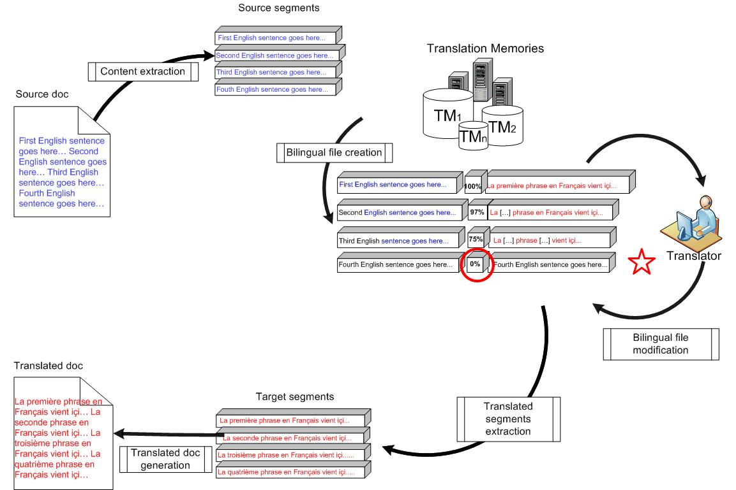
Integration of MT in ETMA: TM only

Slide 13
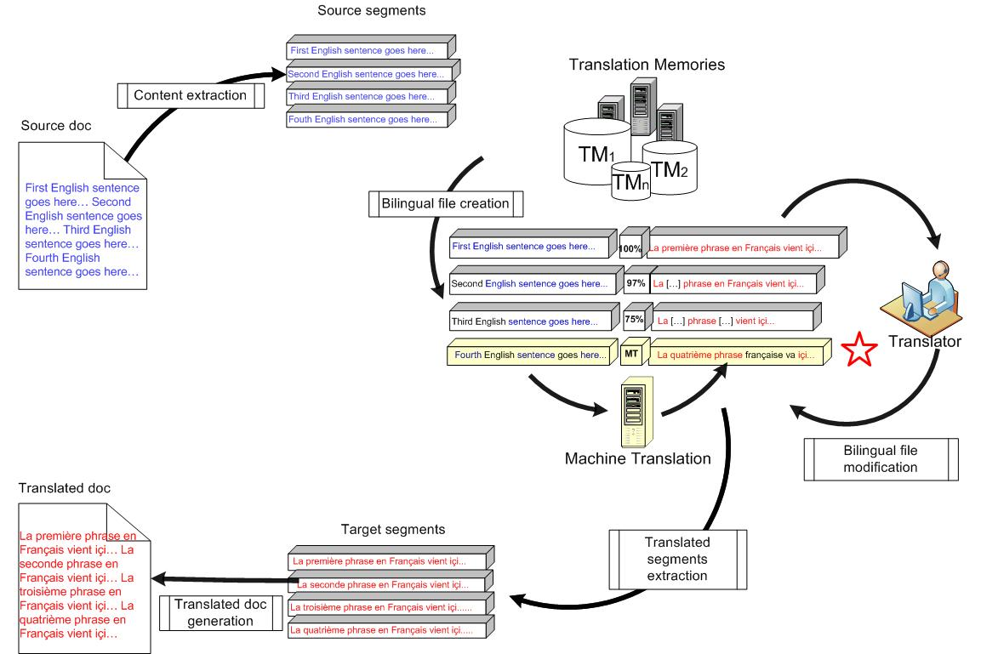
Integration of MT in ETMA: TM + MT for ‘New words’

Slide 14
Thank you

Slide 15
TM leveraging:
Translation
TM Match %
Cost (% of FR)
100%
0%
$=30% of FR
}
30%
$=60% of FR
95%
}
55%
85%
}
60%
75%
100%
High fuzzy match
Low fuzzy match
Source

Slide 16
TM leveraging:
Translation
$ = 30% of FR
$ = 60% of FR
High fuzzy match
Low fuzzy match
Source

Slide 17
MT and Post-edition:
Translation
Higher MT Quality
Lower MT Quality
Source

Slide 18
Thank you

Slide 19
Title (28 pt. HP Simplified bold)
Heading (18 pt. HP Simplified bold HP blue)
Body copy (16 pt. HP Simplified)
Put your first-level bullet here. Try to keep bullet lists simple. (14 pt. HP Simplified)
Put your second-level bullet here. Use no more than you need to explain your point. (14 pt. HP Simplified)
Put your third-level of copy here. Use no more than you need to explain your point. (14 pt. HP Simplified)

Slide 20
Title (28 pt. HP Simplified bold)
Subtitle (18 pt. HP Simplified)
Heading (18 pt. HP Simplified bold HP blue)
Body copy (16 pt. HP Simplified)
Put your first-level bullet here. Try to keep bullet lists simple. (14 pt. HP Simplified)
Put your second-level bullet here. Use no more than you need to explain your point. (14 pt. HP Simplified)
Put your third-level of copy here. Use no more than you need to explain your point. (14 pt. HP Simplified)

Slide 21
Chart style with bulleted copy
Boxes size and quantity may vary, but colors must be maintained.
Attend these sessions
12 pt. HP Simplified bold
After the event
Demo name, Demo number
11 pt. HP Simplified
Demo name, Demo number
Demo name, Demo number
11 pt. HP Simplified
Demo name, Demo number
Contact your sales rep
Visit the website / Facebook /Twitter at: <insert URL here>
Download the whitepaper at: <insert URL here>
Your feedback is important to us. Please take a few minutes to complete the session survey.

