Slide 1
Translation Memories and Translation Memory Sequences in ETMA
What they are? How they work?
September, 2018

Slide 2
Definitions
Translation memory (TM) = database which stores the source text and its corresponding translation in language pairs called “translation units” or segments.
TM Sequences = consolidation of multiple TMs with a notion of order and penalty to be used for a given program + which TM to store new translated content into.

Slide 3
Translation Memories in ETMA
All Translation Memories (TMs) are stored at the HP level in ETMA, to ensure potential leverage between programs in different organizations.
HP
TM Program A
Naming Convention has been defined to ease identification of TM content :
[business unit] [program] [Sub-prog or release or Product Line or Audience] [Vendor] [Legacyxx] [Target locale]
For e.g.:
- For PSG Crystal Commercial content – TM name = BUS_PAN-HP_CRYSTAL_PSG_CRYSTAL_COMM
- For IPG Marketing content managed by Vendor A – TM name = VENDOR_VendorA_IPG_MARKETING
TM Program B
TM Program C – Product Line 1
TM Program C – Product Line 2
TM Program C – Product Line 3
…
TM Vendor A
TM Vendor B
…

Slide 4
TM Sequencing in ETMA – Concept
TM Sequences are set at the Organization level. These are specific to a Program/Vendor.
HP
BU Org
TM to Apply for Reuse
TM to Update
Program A
TM Program A
TM Program A
Program B
TM Program B
TM Program B
TM Program A (with a 2% penalty)
Program C
TM Program C – Product Line 1
TM Program B
TM Program C - xxx
TM Program C – Product Line 2
TM Program A
TM Program C – Product Line 3

Slide 5
TM Sequencing in ETMA – Concept
TM sequence in ETMA will include (see next slide) the following information:
Which TMs to be leveraged (under “Apply Sequence”)
Which TM to be updated with translated content (under “Update Sequence”)
Which penalty to apply to any of the TM selected under the “Apply Sequence”
Note: When a number is added to the “Apply Sequence penalties” field for a TM in the sequence, this percentage is removed from the actual TM percentage.
For e.g. a 100% match with a 2% penalty, will be displayed as a 98% match to the translator.
Additional settings for TM update and reuse can be implemented at the Organization level:
“Only update confirmed segments in TM”: the system will save to the relevant TM only the segments which have been confirmed by the translators.
“Look 100% TM matches”: Any 100% match coming from the TM will not be editable by the translators.

Slide 6
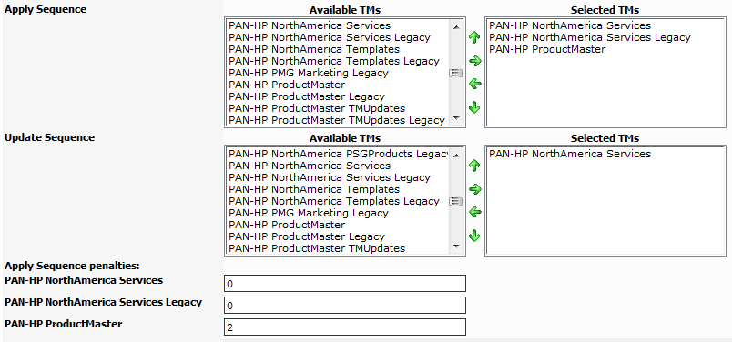
TM Sequencing in ETMA - Example
TM Sequences include the following information:
TMs and TM order
to be used for leverage
TM to store new
translated content to
Penalties applied for
each selected TM

Slide 7
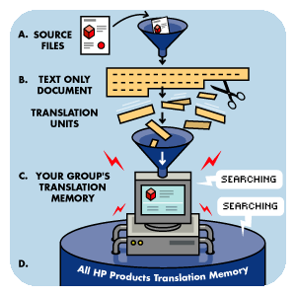
How are TMs Leveraged in ETMA?
The system analyses the files that have been submitted, and identifies the text that must be translated
The system analyses the files that have been submitted, and identifies the text that must be translated
Matches are prioritized according to rules defined for your projects
Matching translation units are inserted into your project, and repetitions are identified, so that they do not have to be translated again—reducing costs
Image by XPLANE

Slide 8
When and How are TMs Updated in ETMA?
Based on TM sequence information, selected TM is updated when a job reaches the “Update TM” stage in the workflow.
Note: This workflow stage takes place at the end of the workflow, usually right before the “Finished” stage.
All translated segments will be stored in the TM specified under “Update Sequence” in the TM sequence for each language pair.
Any new translation for the same source segment will overwrite the previous translation available in the TM.

Slide 9
TM Banding Reuse
Any job created in ETMA will be processed through the selected TM sequence and generate a Banding Word count Report with TM leverage percentages:
Note: PerfectMatch are 100% in context (based on exact/customized file name coming from files previously submitted for the same program

Slide 10
Thank you

